Slide 1
Analysis of Clocked Sequential Circuits
  (inputs, current state) ◊ (output, next state)
  a state transition table or state transition diagram

Slide 2
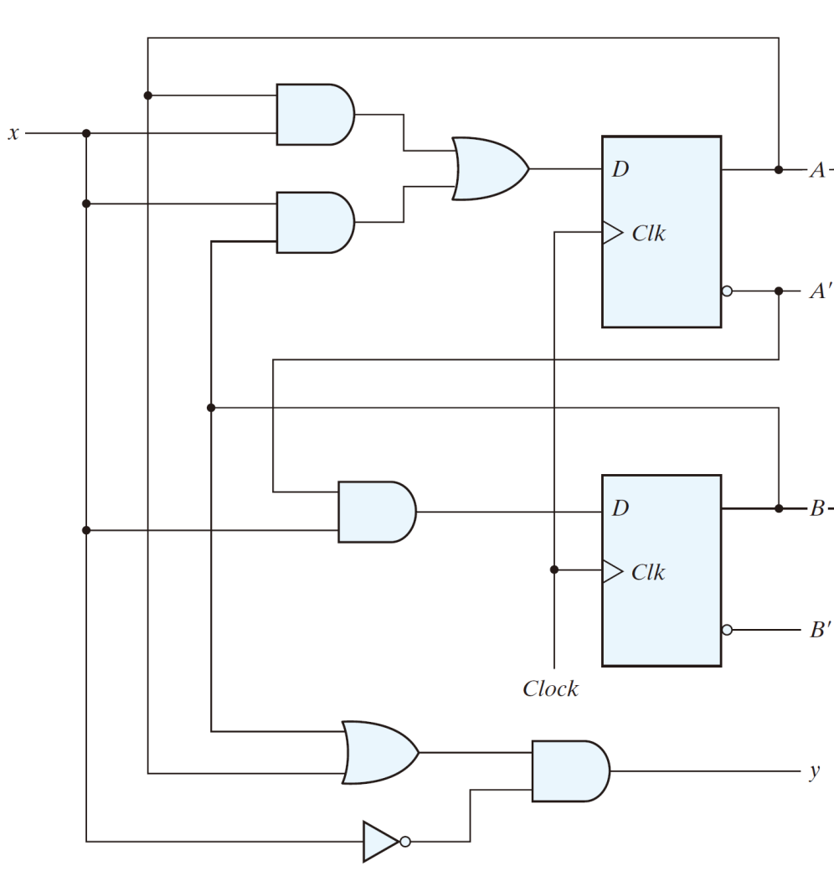

Slide 3
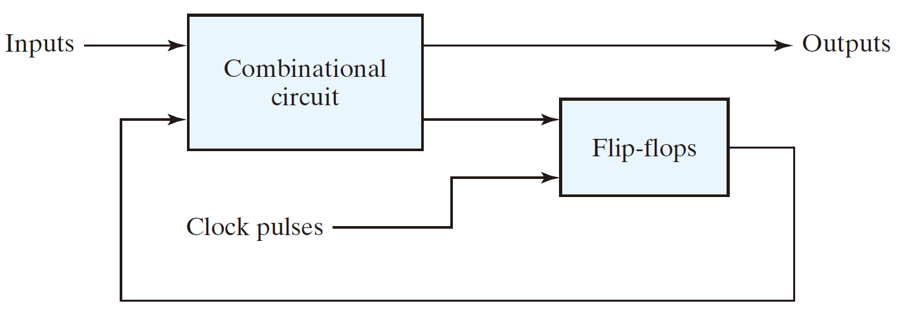
State input (present state)

Slide 4
State input (present state)
A | B | x | D_{A} | D_{B} | A | B | Y

Slide 5
State input (present state)
A | B | x | D_{A} | D_{B} | A | B | Y

Slide 6
State input (present state)
A | B | x | D_{A} | D_{B} | A | B | Y
0 | 0 | 0
0 | 0 | 1
0 | 1 | 0
0 | 1 | 1
1 | 0 | 0
1 | 0 | 1
1 | 1 | 0
1 | 1 | 1

Slide 7
0
0
1
State input (present state)
A | B | x | D_{A} | D_{B} | A | B | Y
0 | 0 | 0
0 | 0 | 1
0 | 1 | 0
0 | 1 | 1
1 | 0 | 0
1 | 0 | 1
1 | 1 | 0
1 | 1 | 1
0

Slide 8
0
0
0
0
1
State input (present state)
A | B | x | D_{A} | D_{B} | A | B | Y
0 | 0 | 0
0 | 0 | 1
0 | 1 | 0
0 | 1 | 1
1 | 0 | 0
1 | 0 | 1
1 | 1 | 0
1 | 1 | 1
1
0
0
0
0
0
1

Slide 9
0
0
0
0
0
1
State input (present state)
A | B | x | D_{A} | D_{B} | A | B | Y
0 | 0 | 0 | 0 | 0 |  |  | 0
0 | 0 | 1
0 | 1 | 0
0 | 1 | 1
1 | 0 | 0
1 | 0 | 1
1 | 1 | 0
1 | 1 | 1
1
0
0
0
0
0
0
0
1

Slide 10
0
0
0
0
0
1
State input (present state)
A | B | x | D_{A} | D_{B} | A | B | Y
0 | 0 | 0 | 0 | 0 |  |  | 0
0 | 0 | 1
0 | 1 | 0
0 | 1 | 1
1 | 0 | 0
1 | 0 | 1
1 | 1 | 0
1 | 1 | 1
1
0
0
0
0
0
0
0
1

Slide 11
0
0
0
0
0
1
State input (present state)
A | B | x | D_{A} | D_{B} | A | B | Y
0 | 0 | 0 | 0 | 0 | 0 | 0 | 0
0 | 0 | 1
0 | 1 | 0
0 | 1 | 1
1 | 0 | 0
1 | 0 | 1
1 | 1 | 0
1 | 1 | 1
1
0
0
0
0
0
0
0
1

Slide 12
1
0
1
State input (present state)
A | B | x | D_{A} | D_{B} | A | B | Y
0 | 0 | 0 | 0 | 0 | 0 | 0 | 0
0 | 0 | 1
0 | 1 | 0
0 | 1 | 1
1 | 0 | 0
1 | 0 | 1
1 | 1 | 0
1 | 1 | 1
0

Slide 13
0
1
0
0
1
State input (present state)
A | B | x | D_{A} | D_{B} | A | B | Y
0 | 0 | 0 | 0 | 0 | 0 | 0 | 0
0 | 0 | 1
0 | 1 | 0
0 | 1 | 1
1 | 0 | 0
1 | 0 | 1
1 | 1 | 0
1 | 1 | 1
1
0
1
0
0
0
0

Slide 14
0
1
0
0
0
1
State input (present state)
A | B | x | D_{A} | D_{B} | A | B | Y
0 | 0 | 0 | 0 | 0 | 0 | 0 | 0
0 | 0 | 1 | 0 | 1 |  |  | 0
0 | 1 | 0
0 | 1 | 1
1 | 0 | 0
1 | 0 | 1
1 | 1 | 0
1 | 1 | 1
1
0
1
1
0
0
0
0
0

Slide 15
0
1
0
0
0
1
State input (present state)
A | B | x | D_{A} | D_{B} | A | B | Y
0 | 0 | 0 | 0 | 0 | 0 | 0 | 0
0 | 0 | 1 | 0 | 1 |  |  | 0
0 | 1 | 0
0 | 1 | 1
1 | 0 | 0
1 | 0 | 1
1 | 1 | 0
1 | 1 | 1
1
0
1
1
0
0
0
0
0

Slide 16
0
1
0
0
0
1
State input (present state)
A | B | x | D_{A} | D_{B} | A | B | Y
0 | 0 | 0 | 0 | 0 | 0 | 0 | 0
0 | 0 | 1 | 0 | 1 | 0 | 1 | 0
0 | 1 | 0
0 | 1 | 1
1 | 0 | 0
1 | 0 | 1
1 | 1 | 0
1 | 1 | 1
1
1
1
1
0
0
0
0
0

Slide 17
0
0
1
State input (present state)
A | B | x | D_{A} | D_{B} | A | B | Y
0 | 0 | 0 | 0 | 0 | 0 | 0 | 0
0 | 0 | 1 | 0 | 1 | 0 | 1 | 0
0 | 1 | 0
0 | 1 | 1
1 | 0 | 0
1 | 0 | 1
1 | 1 | 0
1 | 1 | 1
1

Slide 18
0
0
1
State input (present state)
A | B | x | D_{A} | D_{B} | A | B | Y
0 | 0 | 0 | 0 | 0 | 0 | 0 | 0
0 | 0 | 1 | 0 | 1 | 0 | 1 | 0
0 | 1 | 0
0 | 1 | 1
1 | 0 | 0
1 | 0 | 1
1 | 1 | 0
1 | 1 | 1
1

Slide 19
0
0
0
0
1
State input (present state)
A | B | x | D_{A} | D_{B} | A | B | Y
0 | 0 | 0 | 0 | 0 | 0 | 0 | 0
0 | 0 | 1 | 0 | 1 | 0 | 1 | 0
0 | 1 | 0
0 | 1 | 1
1 | 0 | 0
1 | 0 | 1
1 | 1 | 0
1 | 1 | 1
1
1
0
1
1
0
1

Slide 20
0
0
0
0
0
1
State input (present state)
A | B | x | D_{A} | D_{B} | A | B | Y
0 | 0 | 0 | 0 | 0 | 0 | 0 | 0
0 | 0 | 1 | 0 | 1 | 0 | 1 | 0
0 | 1 | 0 | 0 | 0 |  |  | 1
0 | 1 | 1
1 | 0 | 0
1 | 0 | 1
1 | 1 | 0
1 | 1 | 1
1
1
0
0
1
1
1

Slide 21
0
0
0
0
0
1
State input (present state)
A | B | x | D_{A} | D_{B} | A | B | Y
0 | 0 | 0 | 0 | 0 | 0 | 0 | 0
0 | 0 | 1 | 0 | 1 | 0 | 1 | 0
0 | 1 | 0 | 0 | 0 |  |  | 1
0 | 1 | 1
1 | 0 | 0
1 | 0 | 1
1 | 1 | 0
1 | 1 | 1
1
1
0
0
1
1
1

Slide 22
0
0
0
0
0
1
State input (present state)
A | B | x | D_{A} | D_{B} | A | B | Y
0 | 0 | 0 | 0 | 0 | 0 | 0 | 0
0 | 0 | 1 | 0 | 1 | 0 | 1 | 0
0 | 1 | 0 | 0 | 0 | 0 | 0 | 1
0 | 1 | 1
1 | 0 | 0
1 | 0 | 1
1 | 1 | 0
1 | 1 | 1
1
0
0
0
1
1
1

Slide 23
1
0
1
State input (present state)
A | B | x | D_{A} | D_{B} | A | B | Y
0 | 0 | 0 | 0 | 0 | 0 | 0 | 0
0 | 0 | 1 | 0 | 1 | 0 | 1 | 0
0 | 1 | 0 | 0 | 0 | 0 | 0 | 1
0 | 1 | 1
1 | 0 | 0
1 | 0 | 1
1 | 1 | 0
1 | 1 | 1
1

Slide 24
0
1
0
1
1
State input (present state)
A | B | x | D_{A} | D_{B} | A | B | Y
0 | 0 | 0 | 0 | 0 | 0 | 0 | 0
0 | 0 | 1 | 0 | 1 | 0 | 1 | 0
0 | 1 | 0 | 0 | 0 | 0 | 0 | 1
0 | 1 | 1
1 | 0 | 0
1 | 0 | 1
1 | 1 | 0
1 | 1 | 1
1
1
1
1
1
0
0

Slide 25
0
1
1
0
1
1
State input (present state)
A | B | x | D_{A} | D_{B} | A | B | Y
0 | 0 | 0 | 0 | 0 | 0 | 0 | 0
0 | 0 | 1 | 0 | 1 | 0 | 1 | 0
0 | 1 | 0 | 0 | 0 | 0 | 0 | 1
0 | 1 | 1 | 1 | 1 |  |  | 0
1 | 0 | 0
1 | 0 | 1
1 | 1 | 0
1 | 1 | 1
1
1
1
1
1
1
0
0
0

Slide 26
0
1
1
0
1
1
State input (present state)
A | B | x | D_{A} | D_{B} | A | B | Y
0 | 0 | 0 | 0 | 0 | 0 | 0 | 0
0 | 0 | 1 | 0 | 1 | 0 | 1 | 0
0 | 1 | 0 | 0 | 0 | 0 | 0 | 1
0 | 1 | 1 | 1 | 1 |  |  | 0
1 | 0 | 0
1 | 0 | 1
1 | 1 | 0
1 | 1 | 1
1
1
1
1
1
1
0
0
0

Slide 27
0
1
1
1
1
0
State input (present state)
A | B | x | D_{A} | D_{B} | A | B | Y
0 | 0 | 0 | 0 | 0 | 0 | 0 | 0
0 | 0 | 1 | 0 | 1 | 0 | 1 | 0
0 | 1 | 0 | 0 | 0 | 0 | 0 | 1
0 | 1 | 1 | 1 | 1 | 1 | 1 | 0
1 | 0 | 0
1 | 0 | 1
1 | 1 | 0
1 | 1 | 1
1
1
1
1
1
1
0
0
0

Slide 28
0
1
0
State input (present state)
A | B | x | D_{A} | D_{B} | A | B | Y
0 | 0 | 0 | 0 | 0 | 0 | 0 | 0
0 | 0 | 1 | 0 | 1 | 0 | 1 | 0
0 | 1 | 0 | 0 | 0 | 0 | 0 | 1
0 | 1 | 1 | 1 | 1 | 1 | 1 | 0
1 | 0 | 0
1 | 0 | 1
1 | 1 | 0
1 | 1 | 1
0

Slide 29
0
0
1
0
0
State input (present state)
A | B | x | D_{A} | D_{B} | A | B | Y
0 | 0 | 0 | 0 | 0 | 0 | 0 | 0
0 | 0 | 1 | 0 | 1 | 0 | 1 | 0
0 | 1 | 0 | 0 | 0 | 0 | 0 | 1
0 | 1 | 1 | 1 | 1 | 1 | 1 | 0
1 | 0 | 0
1 | 0 | 1
1 | 1 | 0
1 | 1 | 1
0
0
0
0
1
1
1

Slide 30
0
0
0
1
0
0
State input (present state)
A | B | x | D_{A} | D_{B} | A | B | Y
0 | 0 | 0 | 0 | 0 | 0 | 0 | 0
0 | 0 | 1 | 0 | 1 | 0 | 1 | 0
0 | 1 | 0 | 0 | 0 | 0 | 0 | 1
0 | 1 | 1 | 1 | 1 | 1 | 1 | 0
1 | 0 | 0 | 0 | 0 |  |  | 1
1 | 0 | 1
1 | 1 | 0
1 | 1 | 1
0
0
0
0
0
1
1
1
1

Slide 31
0
0
0
1
0
0
State input (present state)
A | B | x | D_{A} | D_{B} | A | B | Y
0 | 0 | 0 | 0 | 0 | 0 | 0 | 0
0 | 0 | 1 | 0 | 1 | 0 | 1 | 0
0 | 1 | 0 | 0 | 0 | 0 | 0 | 1
0 | 1 | 1 | 1 | 1 | 1 | 1 | 0
1 | 0 | 0 | 0 | 0 |  |  | 1
1 | 0 | 1
1 | 1 | 0
1 | 1 | 1
0
0
0
0
0
1
1
1
1

Slide 32
0
0
0
0
0
1
State input (present state)
A | B | x | D_{A} | D_{B} | A | B | Y
0 | 0 | 0 | 0 | 0 | 0 | 0 | 0
0 | 0 | 1 | 0 | 1 | 0 | 1 | 0
0 | 1 | 0 | 0 | 0 | 0 | 0 | 1
0 | 1 | 1 | 1 | 1 | 1 | 1 | 0
1 | 0 | 0 | 0 | 0 | 0 | 0 | 1
1 | 0 | 1
1 | 1 | 0
1 | 1 | 1
0
0
0
0
0
1
1
1
1

Slide 33
1
1
0
State input (present state)
A | B | x | D_{A} | D_{B} | A | B | Y
0 | 0 | 0 | 0 | 0 | 0 | 0 | 0
0 | 0 | 1 | 0 | 1 | 0 | 1 | 0
0 | 1 | 0 | 0 | 0 | 0 | 0 | 1
0 | 1 | 1 | 1 | 1 | 1 | 1 | 0
1 | 0 | 0 | 0 | 0 | 0 | 0 | 1
1 | 0 | 1
1 | 1 | 0
1 | 1 | 1
0

Slide 34
1
1
1
0
0
State input (present state)
A | B | x | D_{A} | D_{B} | A | B | Y
0 | 0 | 0 | 0 | 0 | 0 | 0 | 0
0 | 0 | 1 | 0 | 1 | 0 | 1 | 0
0 | 1 | 0 | 0 | 0 | 0 | 0 | 1
0 | 1 | 1 | 1 | 1 | 1 | 1 | 0
1 | 0 | 0 | 0 | 0 | 0 | 0 | 1
1 | 0 | 1
1 | 1 | 0
1 | 1 | 1
0
0
1
0
1
1
0

Slide 35
1
1
1
1
0
0
State input (present state)
A | B | x | D_{A} | D_{B} | A | B | Y
0 | 0 | 0 | 0 | 0 | 0 | 0 | 0
0 | 0 | 1 | 0 | 1 | 0 | 1 | 0
0 | 1 | 0 | 0 | 0 | 0 | 0 | 1
0 | 1 | 1 | 1 | 1 | 1 | 1 | 0
1 | 0 | 0 | 0 | 0 | 0 | 0 | 1
1 | 0 | 1 | 1 | 0 |  |  | 0
1 | 1 | 0
1 | 1 | 1
0
0
0
1
0
1
1
0
0

Slide 36
1
1
1
1
0
0
State input (present state)
A | B | x | D_{A} | D_{B} | A | B | Y
0 | 0 | 0 | 0 | 0 | 0 | 0 | 0
0 | 0 | 1 | 0 | 1 | 0 | 1 | 0
0 | 1 | 0 | 0 | 0 | 0 | 0 | 1
0 | 1 | 1 | 1 | 1 | 1 | 1 | 0
1 | 0 | 0 | 0 | 0 | 0 | 0 | 1
1 | 0 | 1 | 1 | 0 | 1 | 0 | 0
1 | 1 | 0
1 | 1 | 1
0
0
0
1
0
1
1
0
0

Slide 37
0
1
0
State input (present state)
A | B | x | D_{A} | D_{B} | A | B | Y
0 | 0 | 0 | 0 | 0 | 0 | 0 | 0
0 | 0 | 1 | 0 | 1 | 0 | 1 | 0
0 | 1 | 0 | 0 | 0 | 0 | 0 | 1
0 | 1 | 1 | 1 | 1 | 1 | 1 | 0
1 | 0 | 0 | 0 | 0 | 0 | 0 | 1
1 | 0 | 1 | 1 | 0 | 1 | 0 | 0
1 | 1 | 0
1 | 1 | 1
0

Slide 38
0
0
1
0
0
State input (present state)
A | B | x | D_{A} | D_{B} | A | B | Y
0 | 0 | 0 | 0 | 0 | 0 | 0 | 0
0 | 0 | 1 | 0 | 1 | 0 | 1 | 0
0 | 1 | 0 | 0 | 0 | 0 | 0 | 1
0 | 1 | 1 | 1 | 1 | 1 | 1 | 0
1 | 0 | 0 | 0 | 0 | 0 | 0 | 1
1 | 0 | 1 | 1 | 0 | 1 | 0 | 0
1 | 1 | 0
1 | 1 | 1
0
0
0
0
1
1
1

Slide 39
0
0
0
1
0
0
State input (present state)
A | B | x | D_{A} | D_{B} | A | B | Y
0 | 0 | 0 | 0 | 0 | 0 | 0 | 0
0 | 0 | 1 | 0 | 1 | 0 | 1 | 0
0 | 1 | 0 | 0 | 0 | 0 | 0 | 1
0 | 1 | 1 | 1 | 1 | 1 | 1 | 0
1 | 0 | 0 | 0 | 0 | 0 | 0 | 1
1 | 0 | 1 | 1 | 0 | 1 | 0 | 0
1 | 1 | 0 | 0 | 0 |  |  | 1
1 | 1 | 1
0
0
0
0
0
1
1
1
1

Slide 40
0
0
0
1
0
0
State input (present state)
A | B | x | D_{A} | D_{B} | A | B | Y
0 | 0 | 0 | 0 | 0 | 0 | 0 | 0
0 | 0 | 1 | 0 | 1 | 0 | 1 | 0
0 | 1 | 0 | 0 | 0 | 0 | 0 | 1
0 | 1 | 1 | 1 | 1 | 1 | 1 | 0
1 | 0 | 0 | 0 | 0 | 0 | 0 | 1
1 | 0 | 1 | 1 | 0 | 1 | 0 | 0
1 | 1 | 0 | 0 | 0 |  |  | 1
1 | 1 | 1
0
0
0
0
0
1
1
1
1

Slide 41
0
0
0
0
0
1
State input (present state)
A | B | x | D_{A} | D_{B} | A | B | Y
0 | 0 | 0 | 0 | 0 | 0 | 0 | 0
0 | 0 | 1 | 0 | 1 | 0 | 1 | 0
0 | 1 | 0 | 0 | 0 | 0 | 0 | 1
0 | 1 | 1 | 1 | 1 | 1 | 1 | 0
1 | 0 | 0 | 0 | 0 | 0 | 0 | 1
1 | 0 | 1 | 1 | 0 | 1 | 0 | 0
1 | 1 | 0 | 0 | 0 | 0 | 0 | 1
1 | 1 | 1
0
0
0
0
0
1
1
1
1

Slide 42
10
1
0
State input (present state)
A | B | x | D_{A} | D_{B} | A | B | Y
0 | 0 | 0 | 0 | 0 | 0 | 0 | 0
0 | 0 | 1 | 0 | 1 | 0 | 1 | 0
0 | 1 | 0 | 0 | 0 | 0 | 0 | 1
0 | 1 | 1 | 1 | 1 | 1 | 1 | 0
1 | 0 | 0 | 0 | 0 | 0 | 0 | 1
1 | 0 | 1 | 1 | 0 | 1 | 0 | 0
1 | 1 | 0 | 0 | 0 | 0 | 0 | 1
1 | 1 | 1
1

Slide 43
1
1
1
1
0
State input (present state)
A | B | x | D_{A} | D_{B} | A | B | Y
0 | 0 | 0 | 0 | 0 | 0 | 0 | 0
0 | 0 | 1 | 0 | 1 | 0 | 1 | 0
0 | 1 | 0 | 0 | 0 | 0 | 0 | 1
0 | 1 | 1 | 1 | 1 | 1 | 1 | 0
1 | 0 | 0 | 0 | 0 | 0 | 0 | 1
1 | 0 | 1 | 1 | 0 | 1 | 0 | 0
1 | 1 | 0 | 0 | 0 | 0 | 0 | 1
1 | 1 | 1
0
1
1
1
1
1
0

Slide 44
1
1
1
1
1
0
State input (present state)
A | B | x | D_{A} | D_{B} | A | B | Y
0 | 0 | 0 | 0 | 0 | 0 | 0 | 0
0 | 0 | 1 | 0 | 1 | 0 | 1 | 0
0 | 1 | 0 | 0 | 0 | 0 | 0 | 1
0 | 1 | 1 | 1 | 1 | 1 | 1 | 0
1 | 0 | 0 | 0 | 0 | 0 | 0 | 1
1 | 0 | 1 | 1 | 0 | 1 | 0 | 0
1 | 1 | 0 | 0 | 0 | 0 | 0 | 1
1 | 1 | 1 | 1 | 0 |  |  | 0
0
0
1
1
1
1
0
1
0

Slide 45
1
1
1
1
1
0
State input (present state)
A | B | x | D_{A} | D_{B} | A | B | Y
0 | 0 | 0 | 0 | 0 | 0 | 0 | 0
0 | 0 | 1 | 0 | 1 | 0 | 1 | 0
0 | 1 | 0 | 0 | 0 | 0 | 0 | 1
0 | 1 | 1 | 1 | 1 | 1 | 1 | 0
1 | 0 | 0 | 0 | 0 | 0 | 0 | 1
1 | 0 | 1 | 1 | 0 | 1 | 0 | 0
1 | 1 | 0 | 0 | 0 | 0 | 0 | 1
1 | 1 | 1 | 1 | 0 |  |  | 0
0
0
1
1
1
1
0
1
0

Slide 46
1
1
1
1
1
0
State input (present state)
A | B | x | D_{A} | D_{B} | A | B | Y
0 | 0 | 0 | 0 | 0 | 0 | 0 | 0
0 | 0 | 1 | 0 | 1 | 0 | 1 | 0
0 | 1 | 0 | 0 | 0 | 0 | 0 | 1
0 | 1 | 1 | 1 | 1 | 1 | 1 | 0
1 | 0 | 0 | 0 | 0 | 0 | 0 | 1
1 | 0 | 1 | 1 | 0 | 1 | 0 | 0
1 | 1 | 0 | 0 | 0 | 0 | 0 | 1
1 | 1 | 1 | 1 | 0 | 1 | 0 | 0
0
0
0
1
1
1
0
1
0

Slide 47
State input (present state)
A | B | x | D_{A} | D_{B} | A | B | Y
0 | 0 | 0
0 | 0 | 1
0 | 1 | 0
0 | 1 | 1
1 | 0 | 0
1 | 0 | 1
1 | 1 | 0
1 | 1 | 1

Slide 48
Flip-flop input equations
  The part of circuit that generates the inputs to flip-flops, also called excitation functions

Slide 49
The Flip-Flop input equations
  A(t + 1) = Ax + Bx
A | B | x | D_{A} | D_{B} | A | B | Y
0 | 0 | 0
0 | 0 | 1
0 | 1 | 0
0 | 1 | 1
1 | 0 | 0
1 | 0 | 1
1 | 1 | 0
1 | 1 | 1

Slide 50
The Flip-Flop input equations
  A(t + 1) = Ax + Bx
A | B | x | D_{A} | D_{B} | A | B | Y
0 | 0 | 0 | 0
0 | 0 | 1 | 0
0 | 1 | 0 | 0
0 | 1 | 1 | 1
1 | 0 | 0 | 0
1 | 0 | 1 | 1
1 | 1 | 0 | 0
1 | 1 | 1 | 1

Slide 51
The Flip-Flop input equations
  A(t + 1) = Ax + Bx
  B(t + 1) = A’x
A | B | x | D_{A} | D_{B} | A | B | Y
0 | 0 | 0 | 0
0 | 0 | 1 | 0
0 | 1 | 0 | 0
0 | 1 | 1 | 1
1 | 0 | 0 | 0
1 | 0 | 1 | 1
1 | 1 | 0 | 0
1 | 1 | 1 | 1

Slide 52
The Flip-Flop input equations
  A(t + 1) = Ax + Bx
  B(t + 1) = A’x
A | B | x | D_{A} | D_{B} | A | B | Y
0 | 0 | 0 | 0 | 0
0 | 0 | 1 | 0 | 1
0 | 1 | 0 | 0 | 0
0 | 1 | 1 | 1 | 1
1 | 0 | 0 | 0 | 0
1 | 0 | 1 | 1 | 0
1 | 1 | 0 | 0 | 0
1 | 1 | 1 | 1 | 0

Slide 53
The Flip-Flop input equations
  A(t + 1) = Ax + Bx
  B(t + 1) = A’x
The output equation
  y = (A + B) · x’
A | B | x | D_{A} | D_{B} | A | B | Y
0 | 0 | 0 | 0 | 0
0 | 0 | 1 | 0 | 1
0 | 1 | 0 | 0 | 0
0 | 1 | 1 | 1 | 1
1 | 0 | 0 | 0 | 0
1 | 0 | 1 | 1 | 0
1 | 1 | 0 | 0 | 0
1 | 1 | 1 | 1 | 0

Slide 54
The Flip-Flop input equations
  A(t + 1) = Ax + Bx
  B(t + 1) = A’x
The output equation
  y = (A + B) · x’
A | B | x | D_{A} | D_{B} | A | B | Y
0 | 0 | 0 | 0 | 0 |  |  | 0
0 | 0 | 1 | 0 | 1 |  |  | 0
0 | 1 | 0 | 0 | 0 |  |  | 1
0 | 1 | 1 | 1 | 1 |  |  | 0
1 | 0 | 0 | 0 | 0 |  |  | 1
1 | 0 | 1 | 1 | 0 |  |  | 0
1 | 1 | 0 | 0 | 0 |  |  | 1
1 | 1 | 1 | 1 | 0 |  |  | 0

Slide 55
The Flip-Flop input equations
  A(t + 1) = Ax + Bx
  B(t + 1) = A’x
The output equation
  y = (A + B) · x’
A | B | x | D_{A} | D_{B} | A | B | Y
0 | 0 | 0 | 0 | 0 |  |  | 0
0 | 0 | 1 | 0 | 1 |  |  | 0
0 | 1 | 0 | 0 | 0 |  |  | 1
0 | 1 | 1 | 1 | 1 |  |  | 0
1 | 0 | 0 | 0 | 0 |  |  | 1
1 | 0 | 1 | 1 | 0 |  |  | 0
1 | 1 | 0 | 0 | 0 |  |  | 1
1 | 1 | 1 | 1 | 0 |  |  | 0

Slide 56
The Flip-Flop input equations
  A(t + 1) = Ax + Bx
  B(t + 1) = A’x
The output equation
  y = (A + B) · x’
A | B | x | D_{A} | D_{B} | A | B | Y
0 | 0 | 0 | 0 | 0 | 0 | 0 | 0
0 | 0 | 1 | 0 | 1 | 0 | 1 | 0
0 | 1 | 0 | 0 | 0 | 0 | 0 | 1
0 | 1 | 1 | 1 | 1 | 1 | 1 | 0
1 | 0 | 0 | 0 | 0 | 0 | 0 | 1
1 | 0 | 1 | 1 | 0 | 1 | 0 | 0
1 | 1 | 0 | 0 | 0 | 0 | 0 | 1
1 | 1 | 1 | 1 | 0 | 1 | 0 | 0

Slide 57
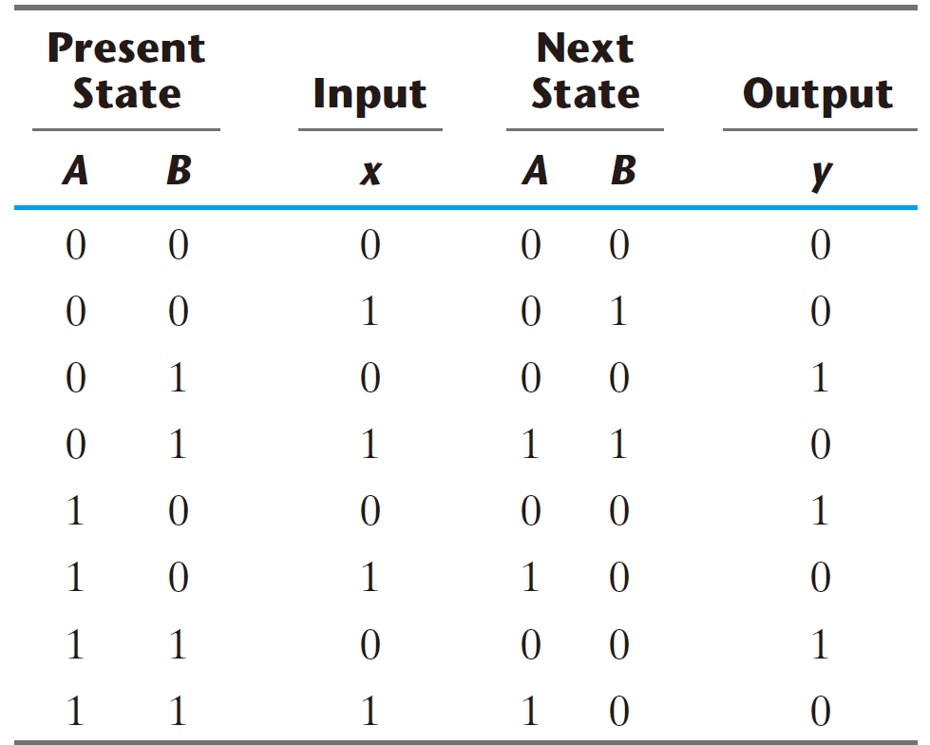
State transition table (Type-1)

Slide 58
State transition table (Type-1)

Slide 59
State transition table (Type-1)

Slide 60
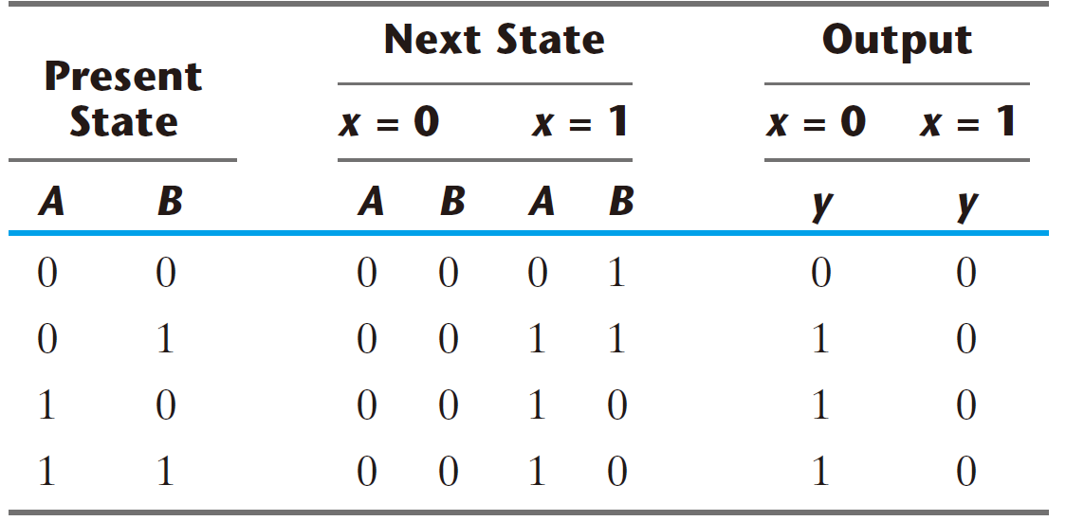
State transition table (Type-2)

Slide 61
State transition table (Type-2)

Slide 62
State transition table (Type-2)

Slide 63
State transition table (Type-2)

Slide 64
State transition table (Type-2)

Slide 65
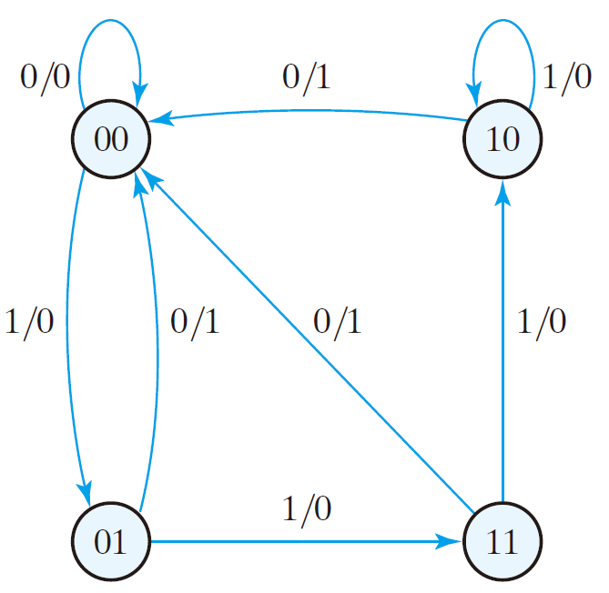
State transition diagram

Slide 66
State transition diagram

Slide 67
State transition diagram

Slide 68
State transition diagram

Slide 69
State transition diagram

Slide 70
  a logic diagram ↔ a state table ↔ a state diagram

